Slide 1


Unite Coding

Slide 2



Hello, we are UNT | Coding. With our project, made by using C++, Visual Studio 2022 and GitHub we have created a platform where you can check your knowledge of the English vocabulary and grammar, there are three different tests you can take based on the difficulty level you pick. Enjoy! - Unite Coding ™

Slide 3
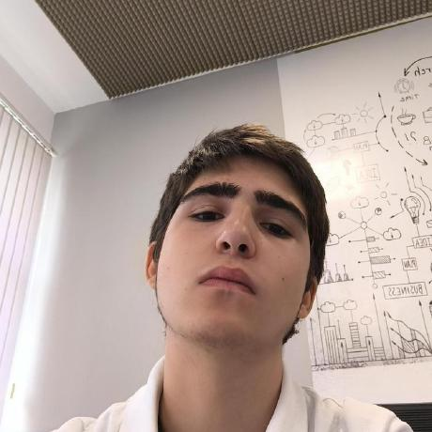
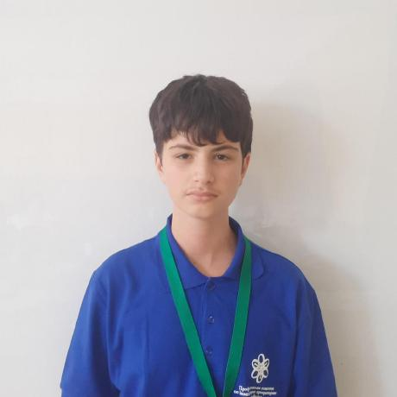
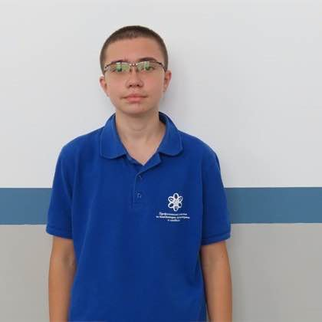
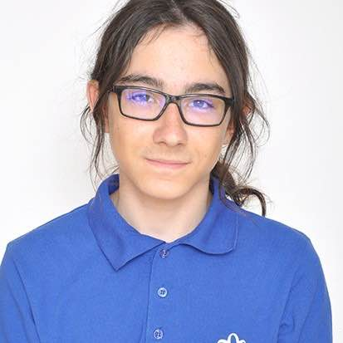
Our Team
Designer
Back-end developer
Scrum trainer
Front-end developer
Emanuil Tinchev 9a
Todor Toromanov 9a
Presiyan Kolev 9a
Aleksandar Kostov 9a

Slide 4
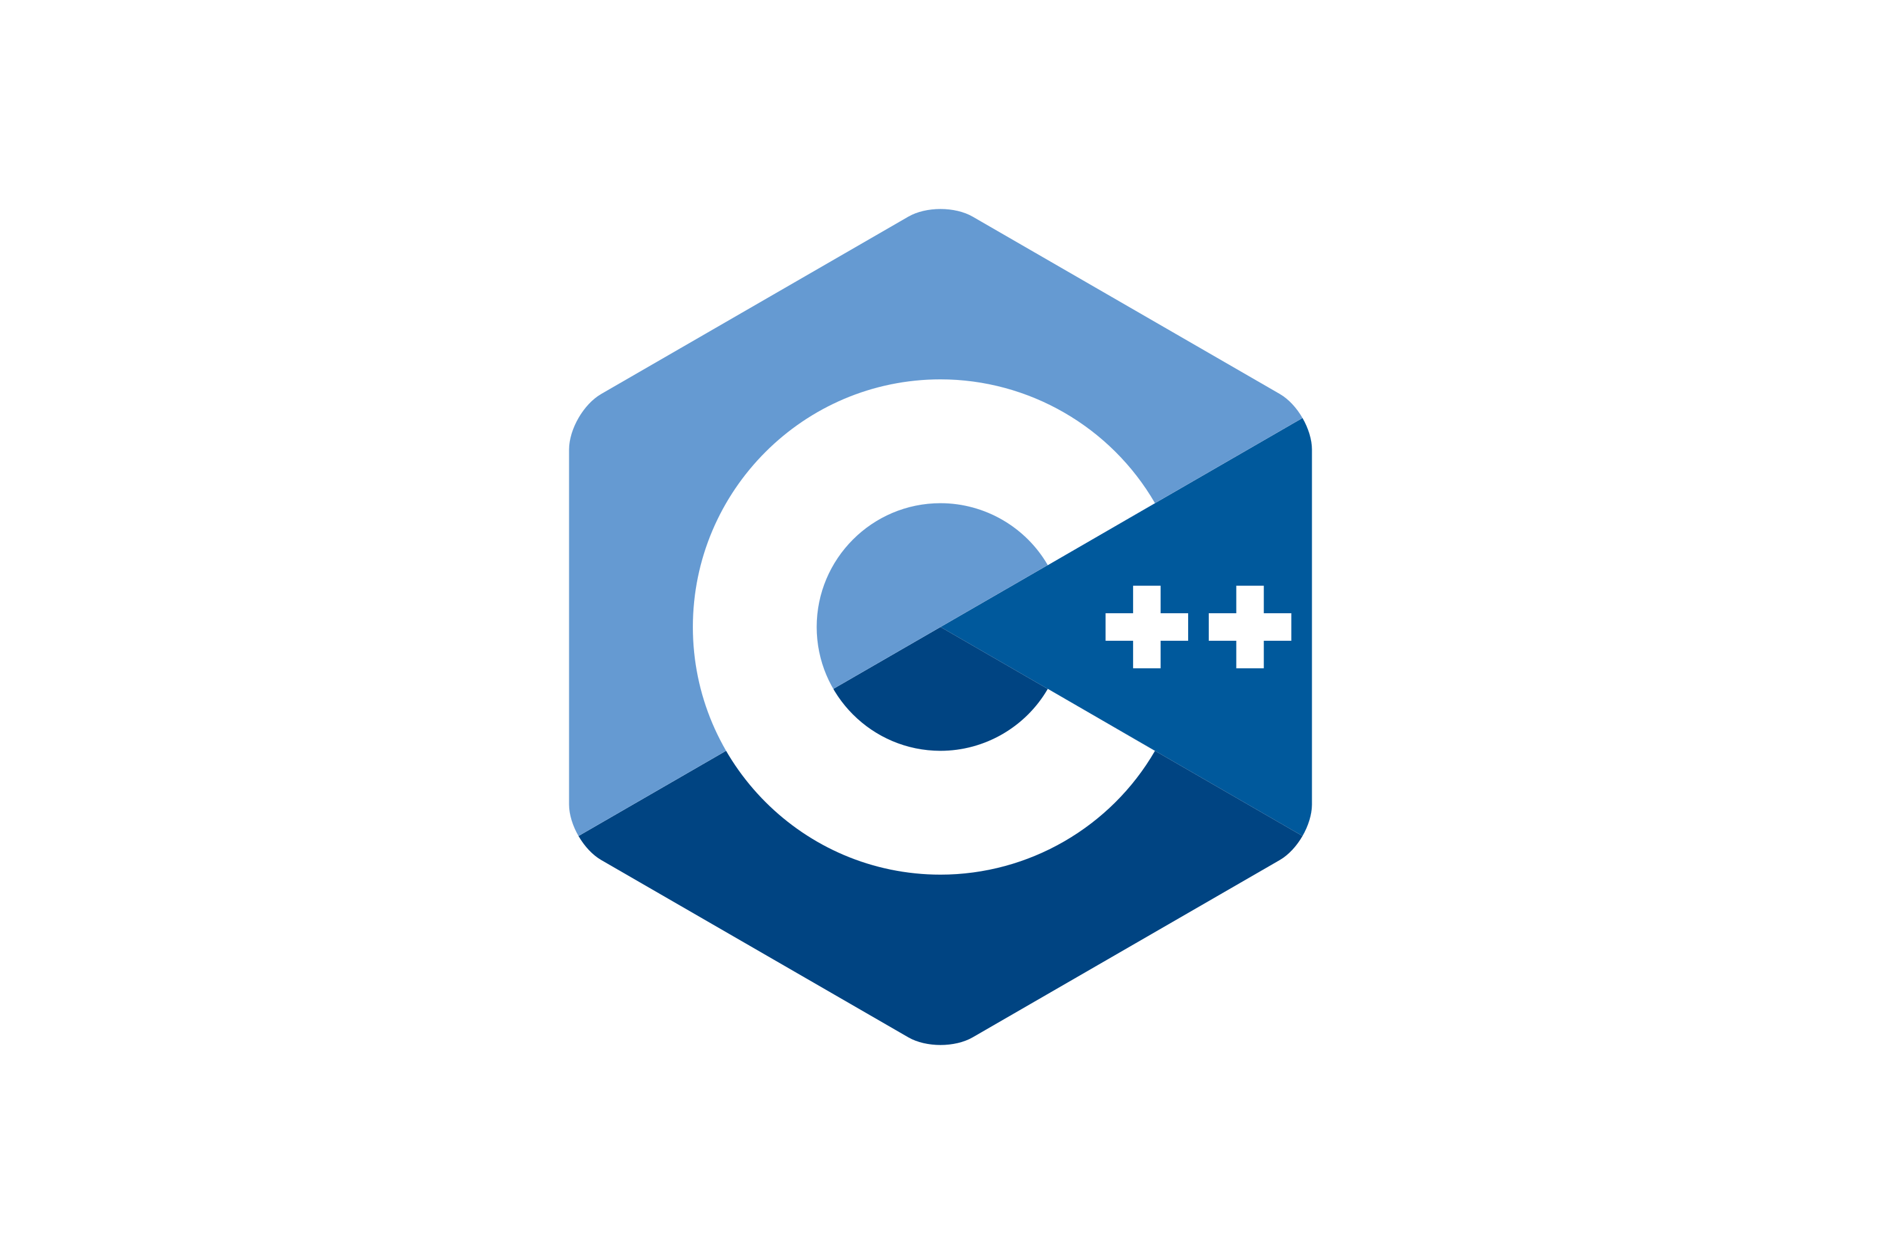


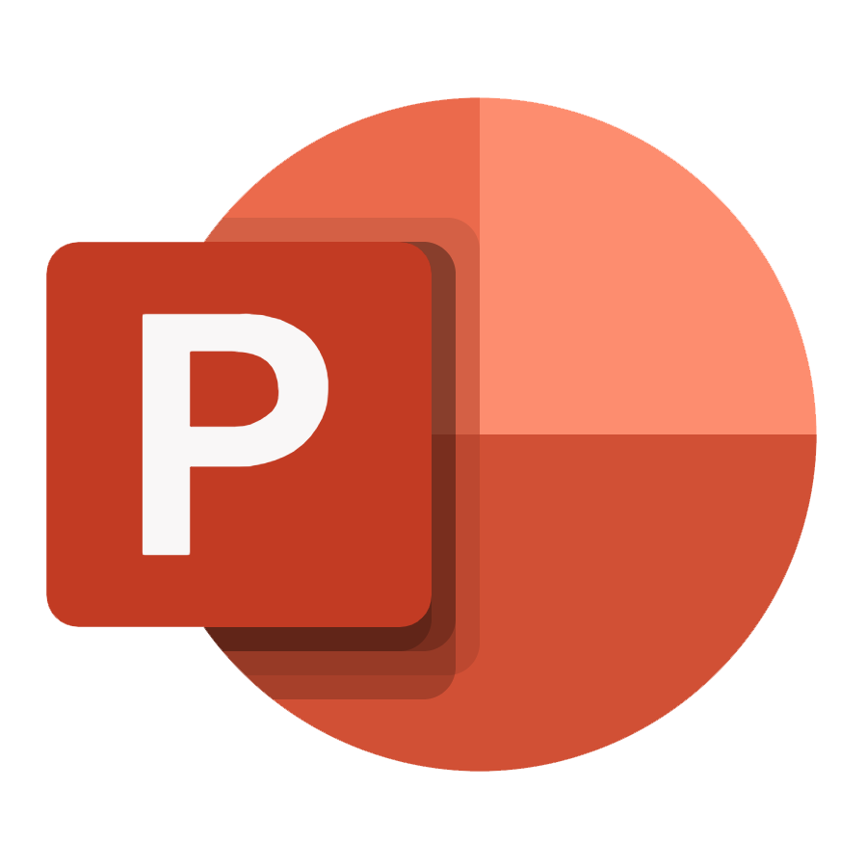

Tools we have used

Slide 5
Thank you for your attention

